Slide 1

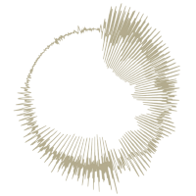
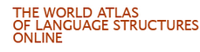
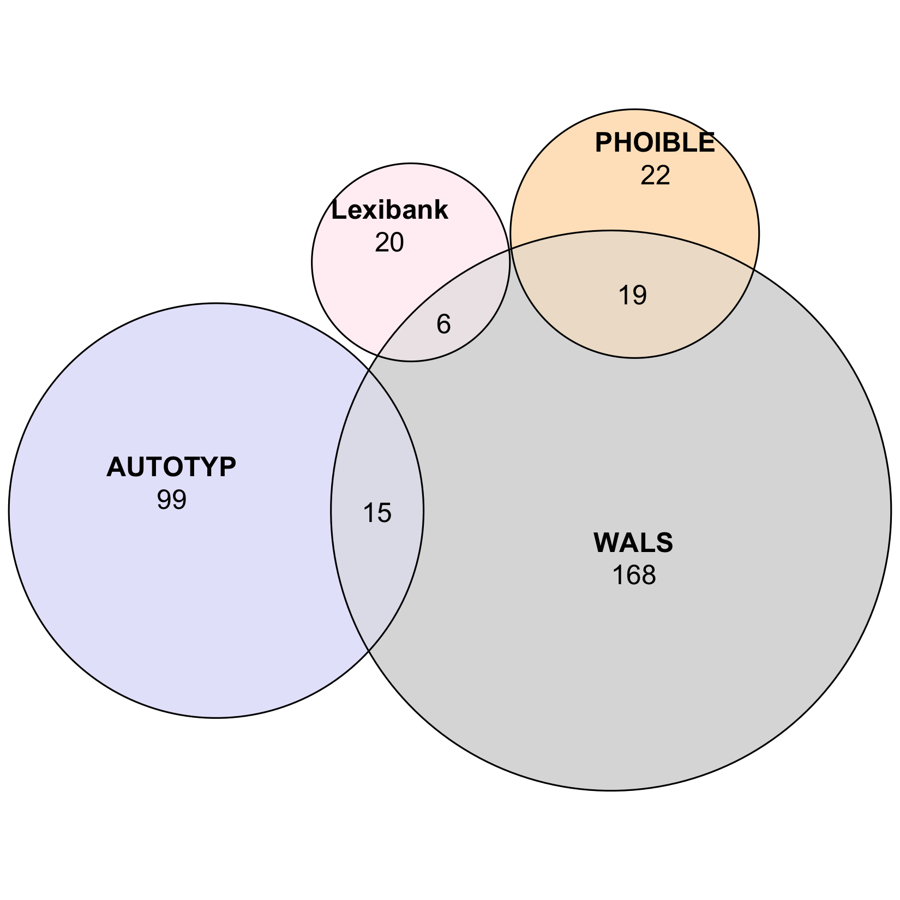
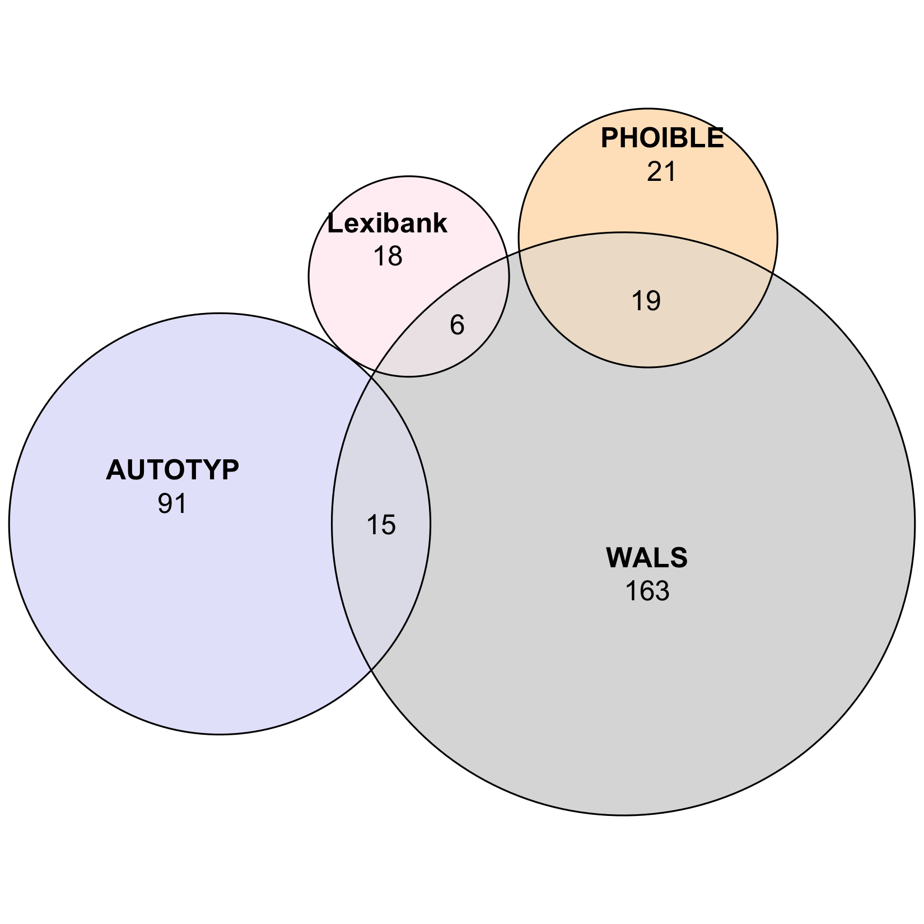
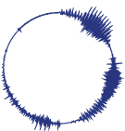

A. GBInd
GBInd logical,
pruned:
149 features
1,455 languages
330 pops
314 pops
GBInd statistical,
pruned:
140 features
1,325 languages
densify
GELATO
densify
413 pops
413 pops
Step 1
logical independence
Step 2
statistical independence*
Grambank:
195 features
2,467 languages
GBInd logical:
203 features
2,467 languages
GBInd statistical:
196 features
2,467 languages
95 retentions
100 removals
108 merges/modifications
158 retentions
45 removals
38 merges/modifications
inputs
curated outputs
WALS:
192 features
2,501 languages
Step 1
logical independence
Step 2
statistical independence*
TypLinkInd logical:
349 features
4,264 languages
TypLinkInd statistical:
333 features
4,262 languages
102 retentions
736 removals
247 merges/modifications
300 retentions
49 removals
33 merges/modifications
AUTOTYP
AUTOTYP:
545 features
1,126 languages
Lexibank:
60 features
2,029 languages
565 pops
565 pops
PHOIBLE:
41 features
2,176 languages
densify
densify
densify
densify
B. TypLinkInd
TypLinkInd logical,
pruned, large:
338 features
1,402 languages
TypLinkInd logical,
pruned, small:
329 features
541 languages
TypLinkInd statistical,
pruned, large:
322 features
1,380 languages
TypLinkInd statistical,
pruned, small:
313 features
538 languages
GELATO
420 pops
269 pops
415 pops
260 pops

